Slide 1


Slide 2



_{Iñ:}g: / Agenda
i
2 Apache Spark
5 4ïîg— : PageRank I1*

Slide 3
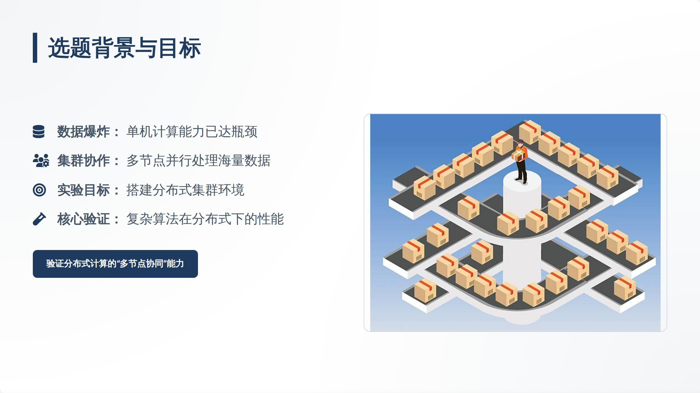

Slide 4
Apache Spark @;/]
@łSpark Ecosystem
i
Ş g@Ë@@ : Ęk MapReduce țQ 10-100 Î
‹/› @@ : @ Python, Java, Scala, R

Slide 5


Spark țÿ‹ğ•ț§,“3"„
i
RDD
Transformation
Action

Slide 6
‹@› 2 Workers : 2C / 1G Ï£@@łȚ@
Master-Worker Architecture

Slide 7

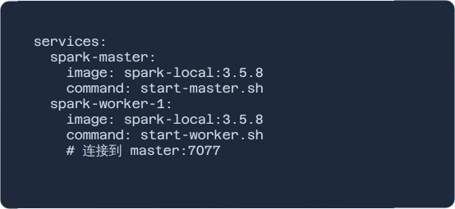
Docker Compose
Wïîy@{$t : Ubuntu 22.04 + OpenJDK 17
ł|ž@ : Spark 3.5.8

Slide 8
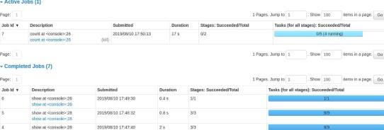
_{i ë*Ș}%jE (Web UI)
ț
: 2 Workers U/ŞÎg
,@@@ : 4 Cores / 2 GB RAM
BJ tel[ : localhost8o8Q

Slide 9
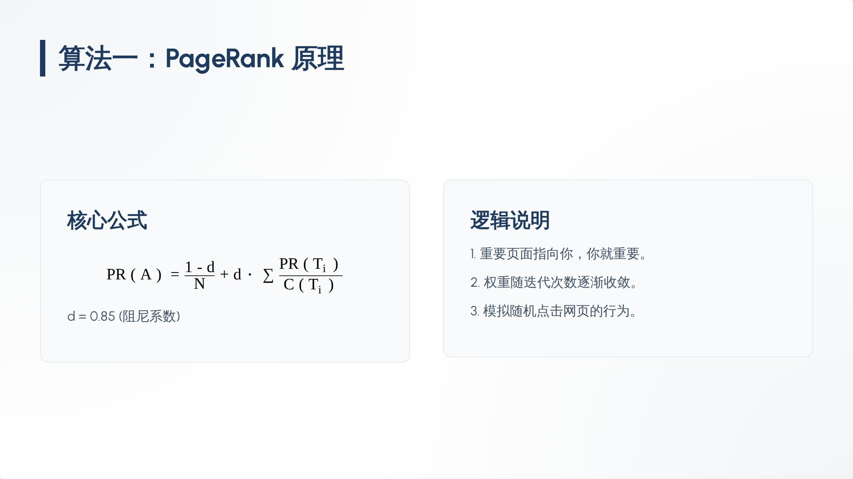

Slide 10


ogeRonk $}3ji@@¿g
i
reduceByKey @{T Shuffle /E,
3
flatMap
5
@§{t@ t , j 10
groupByKey hit@}}tJ
@ gij PR $9@

Slide 11



ogeRonk ÿȚgğŽø:§$
i
 |  | PogeRank
 | G | 0.0ó78I
2 |  | 0.0ó373
3 | D | 0.06157
4 | E | 0.05980
5 | R | 0.05ó42

Slide 12
_{I **}" : TF-IDF @I@
TF - IDF = TF ( t , d ) • log ( ^{N}
di ( t )

Slide 13
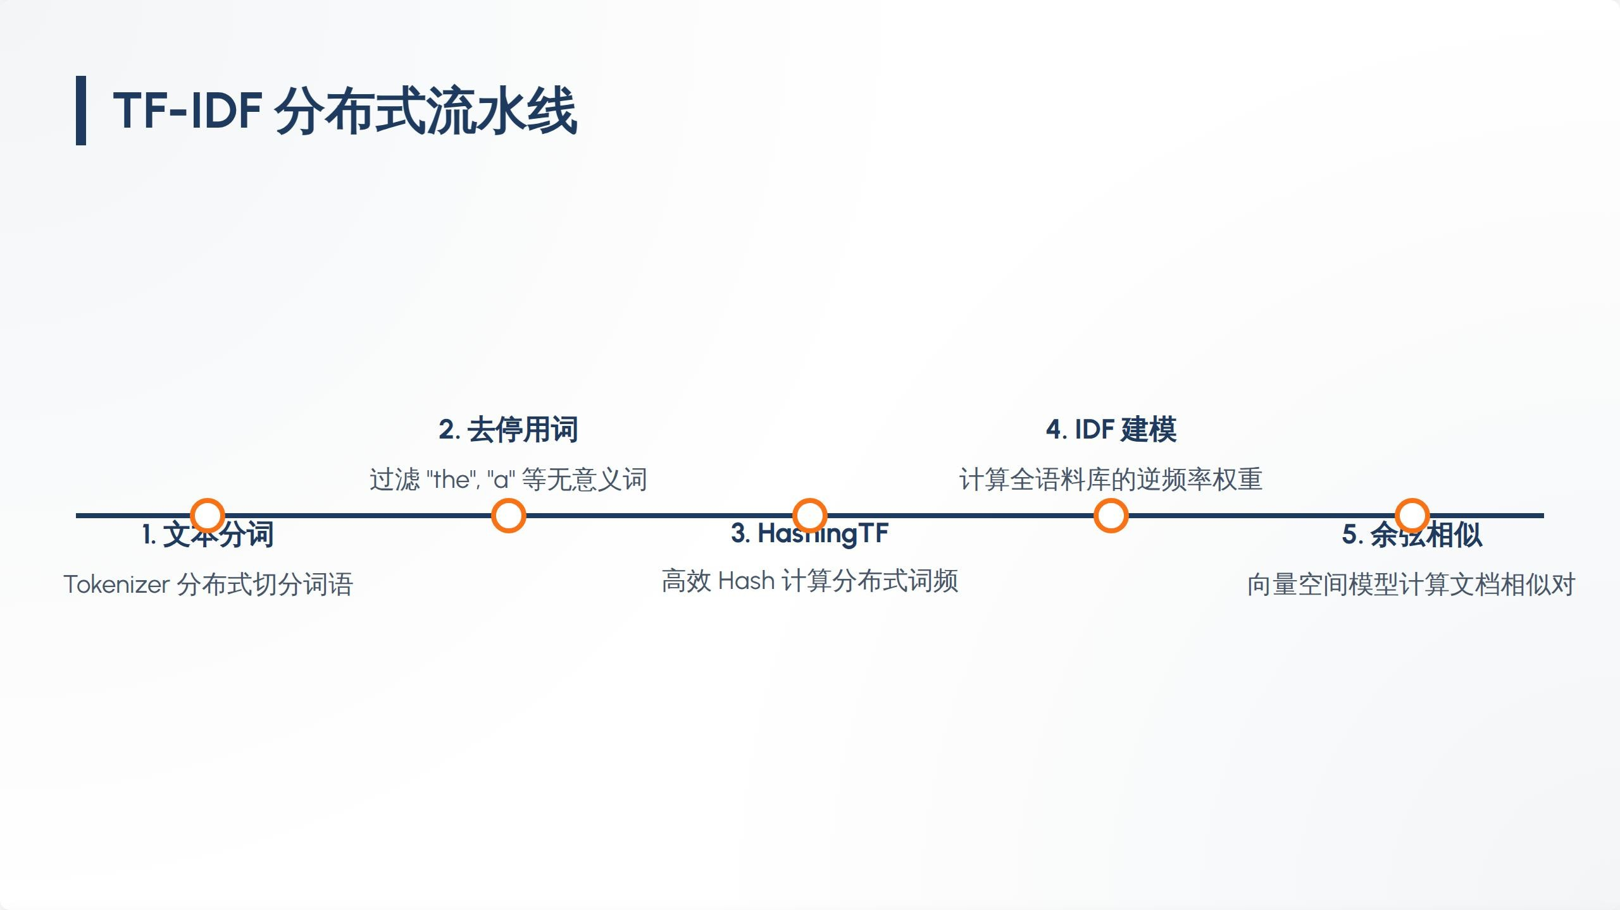

Slide 14



TF-IDF @2|c@{¿tgĄśm:$ć
I
machine learning
neural networks
0.ł854
2
big data
spark framework
0.1665
3
cloud computing
big_data
0.0892
4
neural networks
spark framework
0.0802
5
machine learning
big_dOtO
0.0787

Slide 15
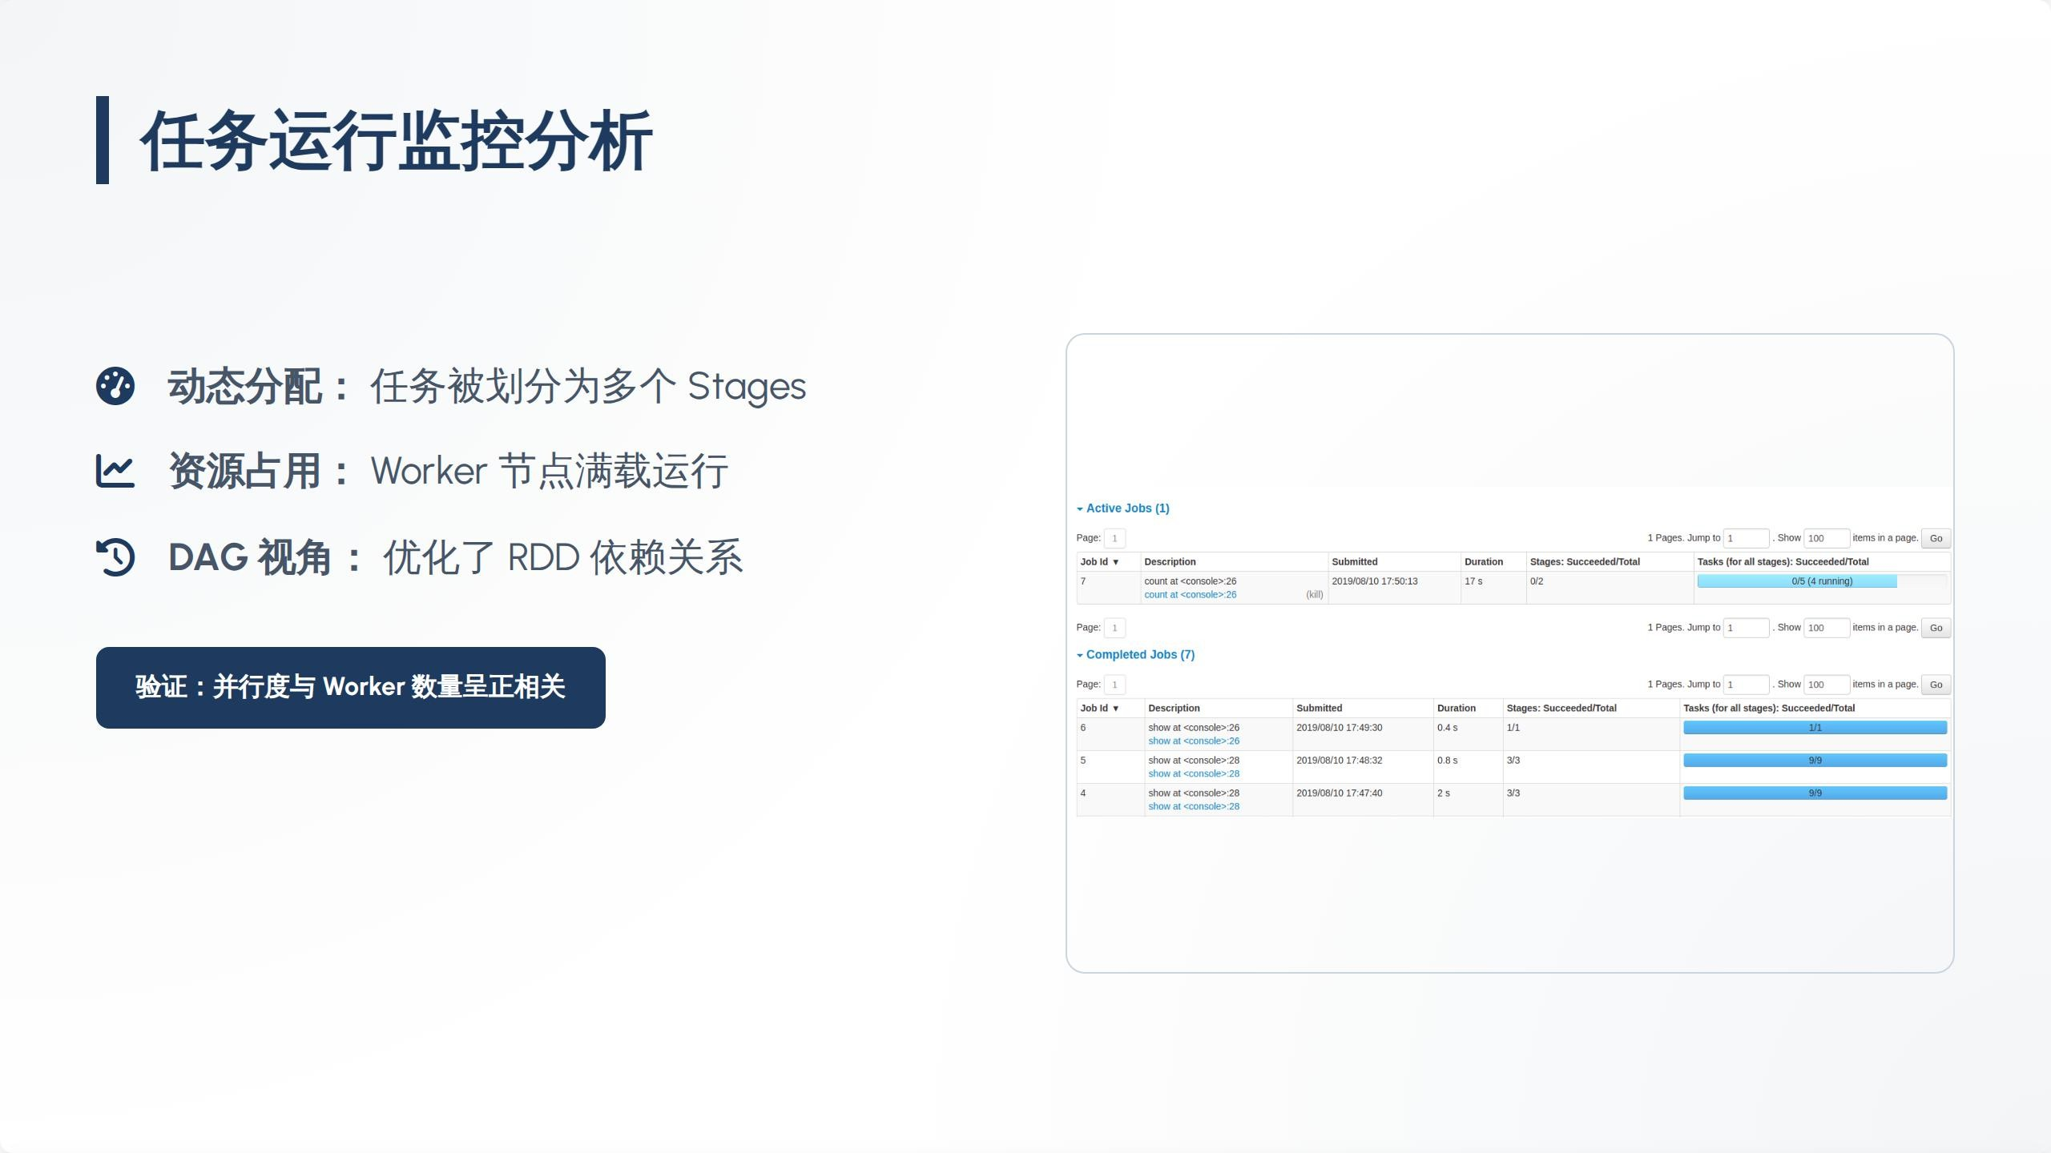

Slide 16






ał8ł6i1‹76 Partition
Master g¿ Task
RDD Lineage \ïfi,@I$Ń
Shuffle @{5

Slide 17


Slide 18




H
e
@jȚlAR Wikipedia ie )§jiğ TF-
IDF g§.
§| Spark Streaming @țȚ @y

Slide 19
THANK YOU
o&A I@in}ltjiTteI
Zaharia M, et ol. “Spark: Cluster Computing with Working Sets." 2010.
Page L, et al. “The PageRank Citation Ranking." 1999.
Apache Spark Official Docs: spark.apache.org

Slide 20



Imoge Sources
https://imoges.seekbgo.com/Iogo-png/61/)/apache-spark—bgo-png_seekIogo-6)6735.png
Source: seeklogo.com
https://medÓ.istockphoto.com/id/221ó0)0815/vector/centroIized-bgisfics-and—distribufion—hub—isometric-iIIustration.jpg?s=ó12xó12&w=0&k=20&c=NJqTtLVuqzNTcoxZ_GV-NcgbXwy 3yyDcMqQqsjN1Cw=
Source: www.istockphoto.com
Thumbnail
for
cnoexl oco e
https://nexocode.com/cdn-cgi/image/width=600,quoIity=75/images/apache_spark_ecosystem.webp
Source: nexocode.com
https://krjnvanroojen.nI/assets/grophics/2025-04-20-beat-spark-cIuster-devcontainer/design.drowio.png
Source: krjnvanrooijen.nI
https://spark.apache.org/docs/lotest/img/AIIJobsPageDetoiI3.png
Source: spark.apache.org
- — -— ”

